Slide 1

IULIA NICOLETA CĂLIN
MAKING COMPARISONS: SIMILES AND METAPHORS
Soft educațional pentru orele de limba engleză
Material realizat în conformitate cu programa școlară în vigoare, aprobată MEC

Slide 2




Our Journey Today
Understanding Comparisons
Similes Explored
The foundation of figurative language
Like stars in the literary sky
Metaphors Unveiled
Practical Applications
The beating heart of description
Crafting your own vivid comparisons

Slide 3

The Power of Comparison
The human mind understands new concepts by relating them to familiar ones. Comparisons bridge the gap between:
The abstract and the concrete
The unfamiliar and the known
The complex and the simple

Slide 4
Comparisons in Literature
"Her eyes were like deep pools of midnight."
"His voice was thunder in the silent room."
"Life is a broken-winged bird that cannot fly."
"All the world's a stage, and all the men and women merely players."
Great writers use comparisons to evoke emotion, create imagery, and forge connections with readers through shared experiences and universal understanding.

Slide 5
What Are Similes?
Definition
Purpose
Effect
A simile is a comparison that uses the words "like" or "as" to draw a parallel between two unlike things that share a common quality.
Similes illuminate unfamiliar concepts by connecting them to familiar ones, making abstract ideas tangible and enhancing descriptive language.
They create immediate, vivid mental images that engage the reader's imagination and evoke sensory experiences beyond plain description.

Slide 6

Similes in Action
Ordinary Description:
The fox moved quickly through the forest.
With Simile:
The fox darted through the forest like a flame dancing among autumn leaves, its russet coat a blur against the earthy palette of the woodland floor.

Slide 7








Types of Similes
Epic Similes
Extended comparisons that develop into detailed illustrations, common in epic poetry. "His words flowed like honey from the comb, sweet and golden and lingering on the tongue."
Direct Similes
Straightforward comparisons using "like" or "as." "Quick as lightning, she solved the puzzle."
Implicit Similes
Negative Similes
Suggest comparison without direct "like" or "as." "She had a lioness's courage when facing adversity."
Define by contrast. "Not like a lamb to the slaughter, but as a wolf to the hunt."

Slide 8

What Are Metaphors?
The Direct Equation
Unlike similes, metaphors directly state that one thing is another, creating a more powerful and immediate identification between the two elements.
They transform the familiar into something new by asserting an identity between dissimilar things, forcing readers to see both in a fresh light.
"Time is a thief."
"Her smile was sunshine breaking through clouds."
"Life is a journey."

Slide 9
The Anatomy of a Metaphor
1
2
The Tenor
The Vehicle
The subject being described or explained (e.g., "life" in "life is a journey").
The thing to which the subject is being compared (e.g., "journey" in "life is a journey").
3
4
The Ground
The Tension
The shared qualities that make the comparison work (e.g., movement, stages, challenges, discoveries).
The dissimilarities that create cognitive dissonance, forcing new perspectives.

Slide 10

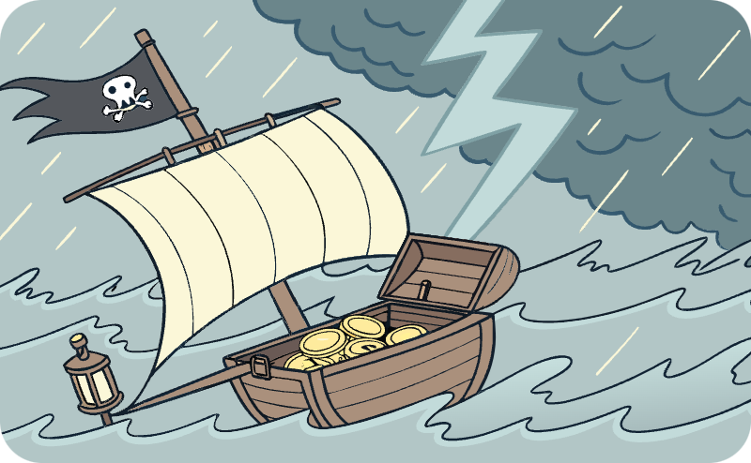


Types of Metaphors
Dead Metaphors
Extended Metaphors
Mixed Metaphors
Conceptual Metaphors
Expressions so common their metaphorical nature has been forgotten: "falling in love," "time flies," "broken heart."
Sustained throughout a piece of writing, often with multiple related comparisons building on the initial metaphor.
Combining unrelated metaphors, often creating humorous or confusing effects: "He's burning bridges by sailing in uncharted waters."
Underlying metaphors that structure how we understand concepts: "ARGUMENT IS WAR" shapes phrases like "defending positions" or "attacking ideas."

Slide 11

Metaphors in Action
Ordinary Description:
With Metaphor:
The old man stood alone in the field.
The old man was an ancient oak, his gnarled limbs reaching skyward, roots deep in the soil of his homeland, weathered by countless seasons yet still standing defiantly against the gathering dusk.

Slide 12
Simile vs. Metaphor: The Key Differences
Feature
Simile
Metaphor
Structure
Uses "like" or "as"
Direct equation (A is B)
Comparison
Suggests similarity
Asserts identity
Effect
More gentle, creates distance
More forceful, creates immediacy
Example
Her voice was like velvet.
Her voice was velvet.
Mental Processing
Allows reader to perceive similarity
Forces reader to see one thing as another

Slide 13










The Sensory Power of Comparisons
Auditory
Visual
"Her laughter was wind chimes in a summer breeze."
"The stars were diamonds scattered across black velvet."
Olfactory
"The kitchen was a French bakery at dawn."
Gustatory
Tactile
"Defeat is a bitter pill to swallow."
"His beard was sandpaper against her cheek."

Slide 14
Avoiding Clichés in Comparisons
Overused Comparisons
Fresh Alternatives
As cold as ice
As cold as a surgeon's gaze
Busy as a bee
Busy as a grandmother's knitting needles
Life is a journey
Life is an unfinished symphony
Time is money
Time is a relentless tide
Hard as a rock
Hard as yesterday's scones
These well-worn phrases have lost their impact through repetition. They no longer create fresh images in readers' minds.
Original comparisons force readers to engage with your writing and see the world through a unique lens.

Slide 15
Creating Effective Comparisons
Consider Your Reader
Identify the Key Quality
Choose vehicles that will resonate with your audience's experiences and knowledge.
Determine precisely what aspect of your subject you want to highlight through comparison.
Test for Clarity and Impact
Seek Unexpected Connections
Ensure your comparison clarifies rather than confuses, and strengthens rather than weakens your point.
Look beyond the obvious to find surprising yet fitting comparisons that will delight and enlighten.

Slide 16
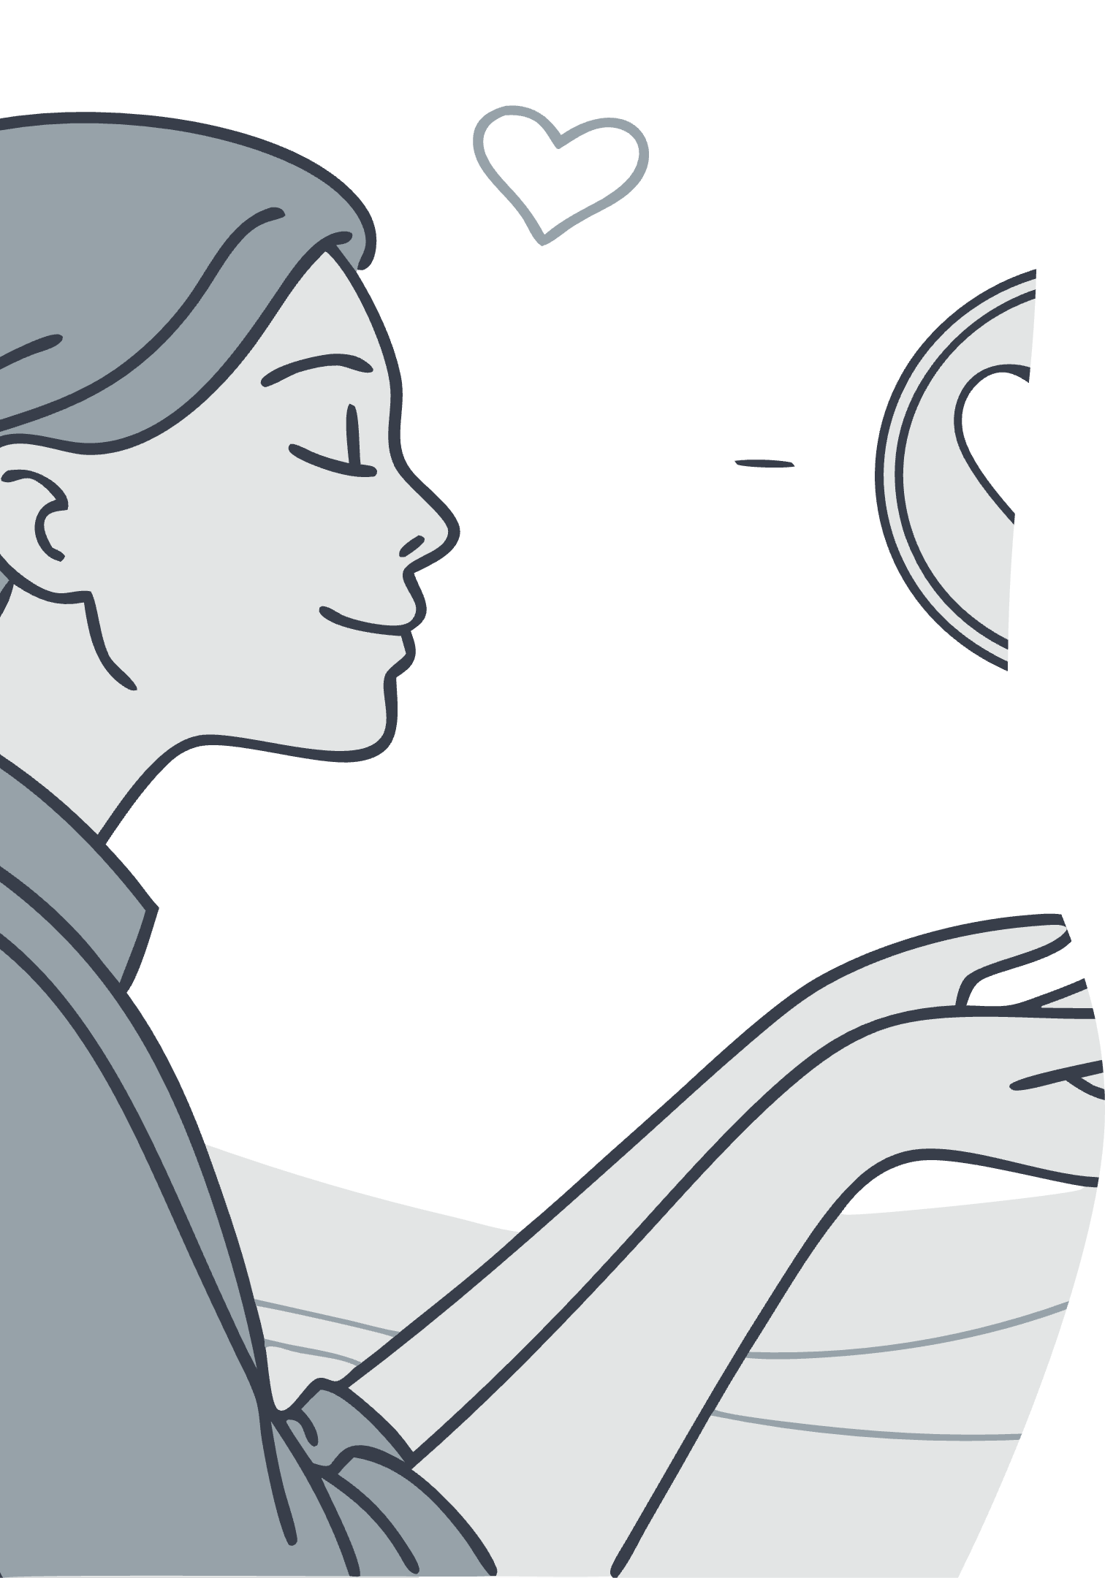
Comparing the Abstract
Emotions
Ideas
"Her jealousy was a thorny vine, wrapping around her heart and squeezing until she could hardly breathe."
"Democracy is a delicate ecosystem, requiring constant tending and protection from invasive elements."
Time
"The afternoon stretched before him like an empty motorway, endless and without feature."

Slide 17
Practice: Transform These Sentences
Plain Statements
With Similes or Metaphors
The city was noisy.
The city was a beehive, humming with ceaseless activity.
The old woman moved slowly.
The child was excited.
The old woman moved like autumn leaves drifting to the ground.
The forest was dense.
The politician spoke persuasively.
The child was a fizzy drink, bubbling over with anticipation.
The forest was a green cathedral, its branches forming gothic arches.
The politician's words were fishing hooks, baited to catch unwary listeners.

Slide 18
Common Pitfalls to Avoid
1
2
Overuse
Forced Connections
Too many comparisons in close proximity overwhelm readers and diminish impact. Use sparingly for maximum effect.
Comparisons that require excessive explanation or feel unnatural create confusion rather than clarity.
3
4
Mixed Metaphors
Cultural Insensitivity
Combining unrelated metaphors creates jarring cognitive dissonance: "She's burning bridges while climbing the ladder of success."
Comparisons that rely on stereotypes or culturally specific references may alienate or confuse diverse audiences.

Slide 19
Famous Examples in Literature
"But soft! What light through yonder window breaks? It is the east, and Juliet is the sun."
"Life's but a walking shadow, a poor player, That struts and frets his hour upon the stage, And then is heard no more."
- William Shakespeare, Romeo and Juliet
- William Shakespeare, Macbeth
"My love is like a red, red rose, That's newly sprung in June."
"Hope is the thing with feathers That perches in the soul."
- Robert Burns, A Red, Red Rose
- Emily Dickinson

Slide 20
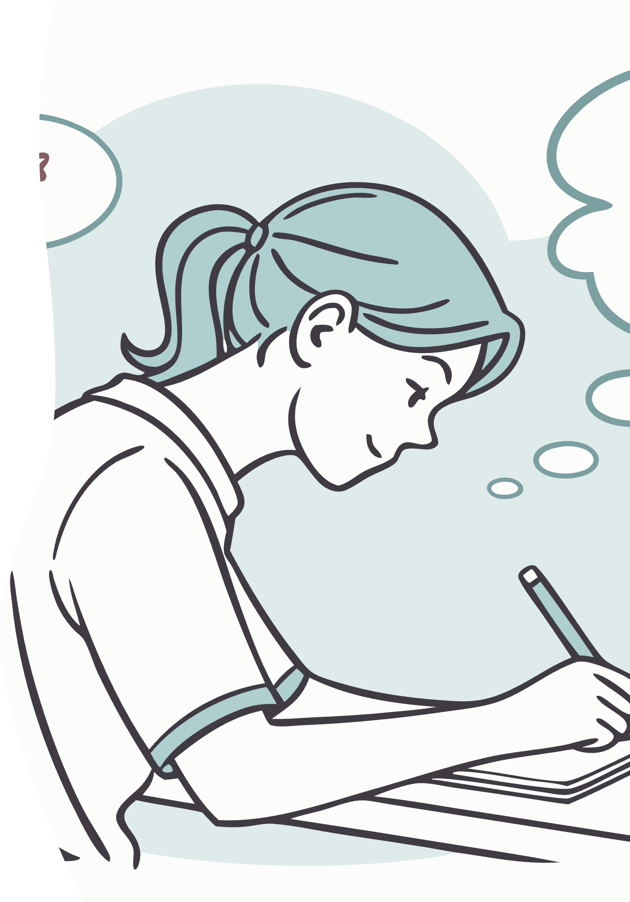
Your Turn: The Comparison Challenge
Create your own similes and metaphors for:
An emotion you've felt recently
A place that's important to you
Example: "My anxiety was a flock of startled birds, impossible to calm or count."
Example: "My grandmother's kitchen is a time machine, transporting me to childhood with each familiar scent."
A person who influences you
Example: "My teacher is a lighthouse, steadily guiding students through foggy uncertainties toward clear understanding."

Slide 21
Bibliografie:
Cazan, A. (2016). Stilistică și expresivitate în limba engleză. București: Editura Universității din București.
Gălbează, C. (2020). Limbaj figurat în limba engleză: resurse stilistice și interpretare. Iași: Polirom.
Lazar, G. (1993). Literature and Language Teaching: A Guide for Teachers and Trainers. Cambridge: Cambridge University Press.
Knowles, M., & Moon, R. (2006). Introducing Metaphor. London: Routledge.
Lakoff, G., & Johnson, M. (2003). Metaphors We Live By (2nd ed.). Chicago: University of Chicago Press.
Kennedy, X. J., & Gioia, D. (2013). Literature: An Introduction to Fiction, Poetry, Drama, and Writing (12th ed.). Boston: Pearson.
Glucksberg, S. (2001). Understanding Figurative Language: From Metaphor to Idioms. Oxford: Oxford University Press.
Abrams, M. H. (1999). A Glossary of Literary Terms (7th ed.). Boston: Heinle & Heinle.

