Slide 1

Clasa a V-a
Profesor Nanu Raluca

Slide 2

Present SIMPLE
We use the simple present to talk about:
Eva wakes up at half past seven every morning.
Repeated
actions or hobbies
I ride my bike every weekend.
Permanent situations or general truths
The English drink a lot of tea.
Many people speak English.

Slide 3
Can you match the correct form of the irregular verb ‘to be’ to each pronoun?
I _____
You _____
He / She / It _____
We _____
You _____
They _____
am
are
are
is
are
are
What do you notice about the verb forms?

Slide 4

To make sentences we need subject+verb
run
I _____
You _____
He / She / It _____
We _____
You _____
They _____
run
runs
run
run
run
What do you notice about the verb forms?

Slide 5
Can you match the correct form of the irregular verb ‘to sing’ to each pronoun?
I _____
You _____
He / She / It _____
We _____
You _____
They _____
sing
sing
sing
sing
sing
sings
What do you notice about the verb forms?

Slide 6
The form of the verb depends on the subject.
run
I you we they
sing
laugh
he she it
(third person singular)
runs
sings
laughs
SUBJECT+VERB + S / ES (3RD PERSON SINGULAR)

Slide 7
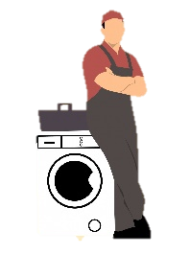

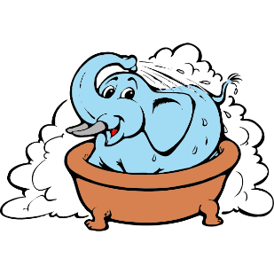

Spelling Rules
The spelling of the verb depends on the ending of the verb.
Verbs ending in:
-o, -ch, -sh, -ss, -s, -x or -z
add -es
Examples:
fix
- washes
– fixes
go
– goes
wash
buzz
- buzzes

Slide 8



Consonant + -y
Remove –y and
add -ies
Examples:
carry
– carries
cry
tidy
- tidies
– cries

Slide 9
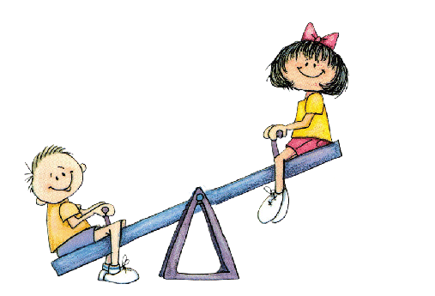


Vowel and -y
Just add -s
Examples:
say
– says
play
– plays
buy
- buys

Slide 10
Are these simple present sentences correct or incorrect?

I likes pizza a lot.
Is this correct?

My mother cooks really well.
Is this correct?

They plays tennis every Saturday.
Is this correct?
Can you write the correct sentences?

Slide 11
This sentence has been mixed up. Can you put it in the right order?
teeth her She brushes a twice day.
Show answer
She brushes her teeth twice a day.
Challenge
Can you write your own mixed-up sentence for your partner?

Slide 12
This sentence has been mixed up. Can you put it in the right order?
speaks He French home. at
Show answer
He speaks French at home.
Challenge
Can you write your own mixed-up sentence for your partner?

Slide 13


Can you sort the sentences? Put the correct simple present tense sentences into the box and the incorrect ones in the rubbish bin.
She watchs the TV.
They visit their uncle every week.
Mark go to bed late.
Christina speaks English and German.
My dad drives to work every day.
My mother works in a shop.

Slide 14
