Slide 1
The four seasons
Autor: Erculescu Denisa Florina
Şcoala Gimnazială ,,Mihai Viteazul” Târgovişte

Slide 2
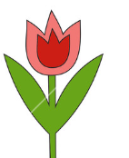
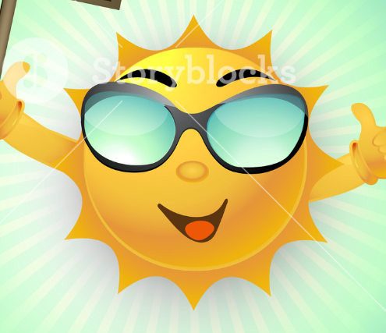

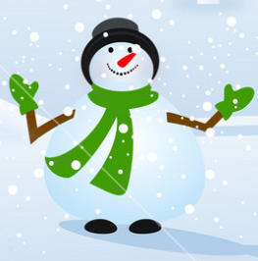
Read the following information about the seasons, then say if the statement are true or false:
Spring
In spring, the weather is warm and sunny. The trees and the grass are green. Therea re a lot of flowers. The birds sing happily. Spring is the year’s most beautiful ,,princess”.
Summer
In summer, it is hot and sunny. It is holiday, so you can go to the seaside, to the mountains or to the country. Nature is at its best. The fields are full of flowers. You can swim in the sea or hike in the forest. Summer is bright, it is the stylish ,,princess” of the year.
Autumn
In autumn it is chilly and windy. It rains a lot. You can pick a lot of fruit and vegetables. School begins. Dressed in yellow and brown clothes, autumn is the richest ,,princess” of the year.
Winter
In winter it is very cold. It snows a lot, you can play with snowballs or make snowmen. You can go skating or skiing. It is time for Christmas tree, candies, toys, celebrations. Winter is the happiest ,,princess” of the year.

Slide 3
Answer true (T) or false (F), according to the texts:
The weather in spring is warm and sunny.
In spring, you can go to the seaside.
Summer is the richest ,,princess” of the year.
It is hot and sunny in the summer.
School begins in summer.
It rains a lot in spring.
In autumn, you can pick a lot of fruit and vegetables.
Christmas is in winter.
People go skating or skiing in winter.
10.You can make a snowball in summer.

Slide 4
Answers:
T
F
F
T
F
F
T
T
T
F

