Slide 1

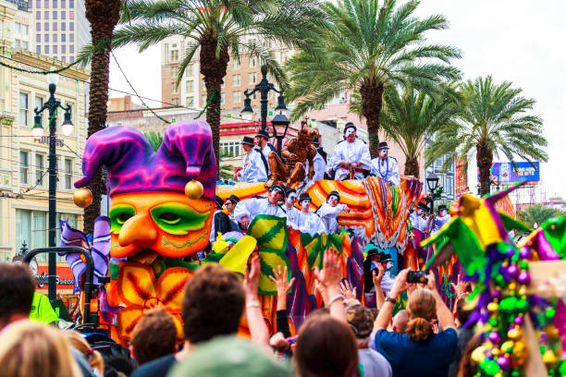
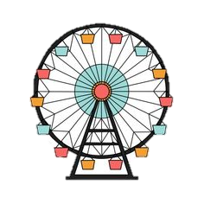

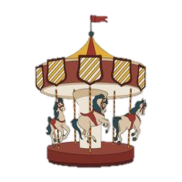

Rio de Janeiro Carnival

Slide 2
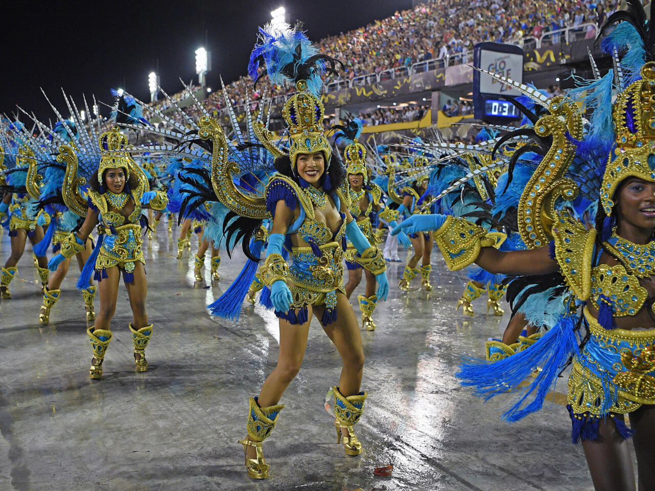
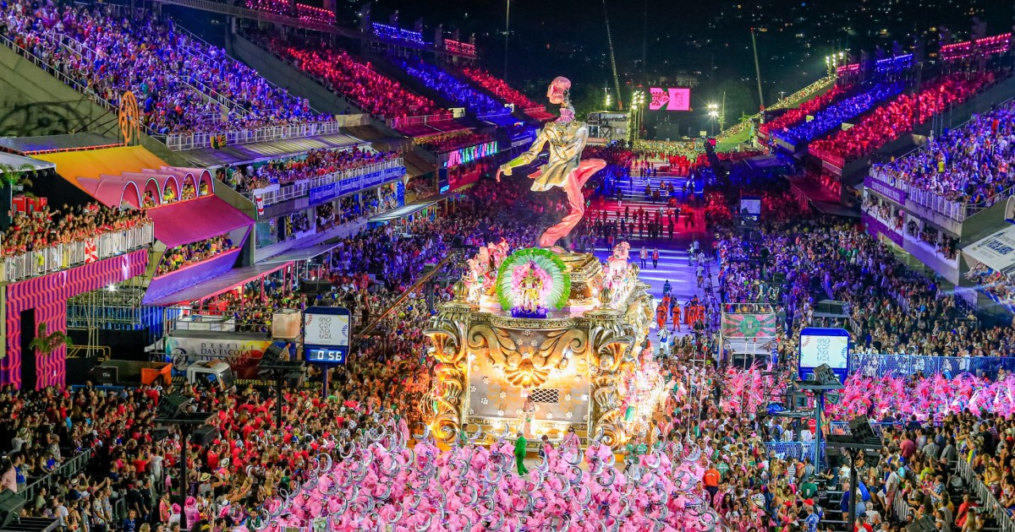
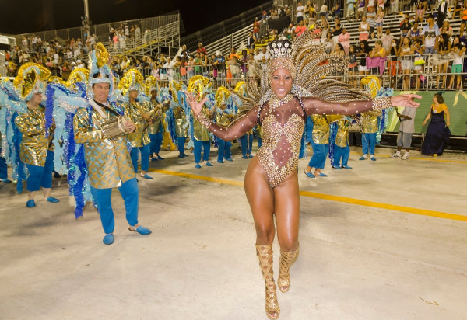
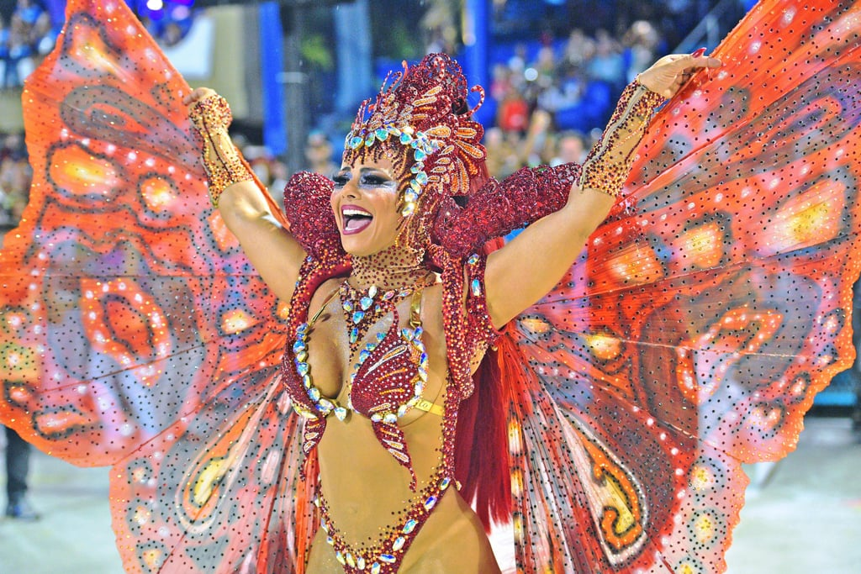
RIO DE JANEIRO CARNIVAL
The Rio de Janeiro Carnival is one of the largest and most impressive festivals in the world, celebrated annually in the Brazilian capital, Rio de Janeiro. It is a cultural event of incredible magnitude, attracting the attention and participation of millions of people from around the globe.

Slide 3
RIO DE JANEIRO CARNIVAL
Start Date: The Rio de Janeiro Carnival typically begins in the last week of February or the first week of March, depending on the date of Easter. It is a five-day festival, culminating on a Tuesday, known as "Mardi Gras".

Slide 4
RIO DE JANEIRO CARNIVAL
What it consists of: The Carnival is an explosion of color, music, and dance. The city streets are filled with spectacular parades, concerts, street balls, and other cultural events. Samba is the heart and soul of this festival, and samba dancers practice and prepare for this event long in advance.

Slide 5
RIO DE JANEIRO CARNIVAL
Number of participants: The Rio de Janeiro Carnival attracts over 2 million people annually, whether they are locals or tourists from around the world.

Slide 6
RIO DE JANEIRO CARNIVAL
Structure of a costume: Carnival costumes are elaborate and colorful, expressing the creativity and culture of Brazil. They often include elements such as feathers, sequins, beads, and other shiny decorations. Samba dancers participating in parades wear bright and elaborate costumes representing different cultural themes and motifs.

Slide 7
RIO DE JANEIRO CARNIVAL
Most popular costume of the year: Every year, there are costumes that attract attention and become famous. For example, in the previous year, the "Rainha de Bateria" (Queen of the Drum Section) costume, worn by the queen of a samba school, was one of the most popular and impressive costumes.

Slide 8
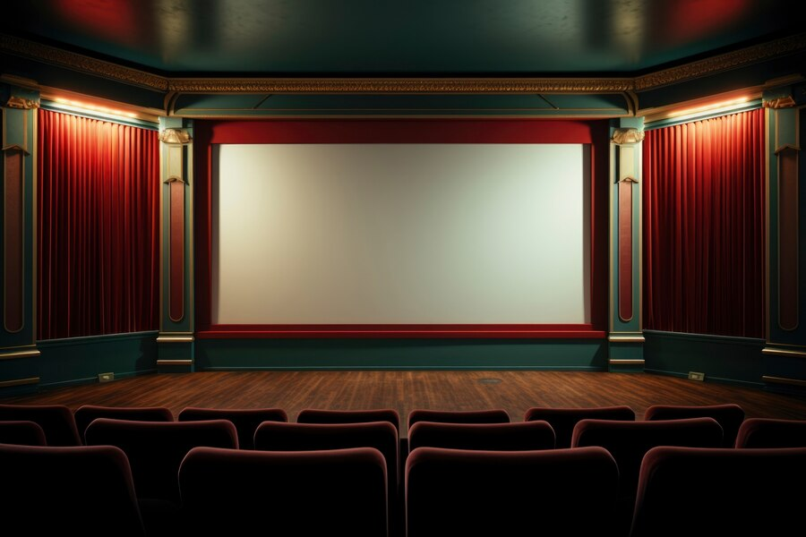
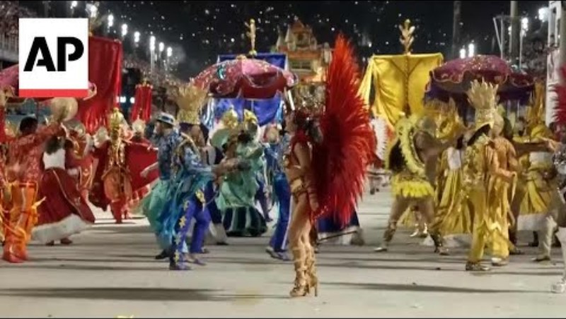

Slide 10
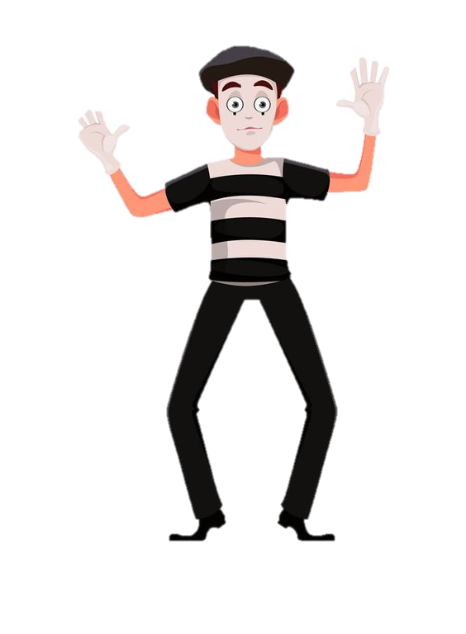
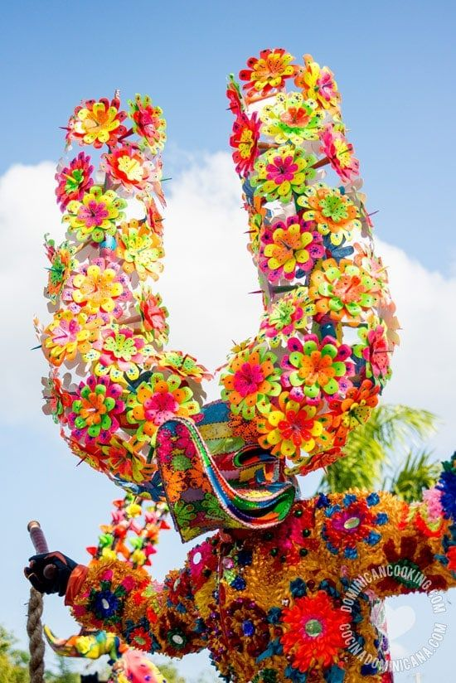
Bibliography
https://ro.wikipedia.org/wiki/Carnavalul_de_la_Rio
https://stirileprotv.ro/divers/carnavalul-de-la-rio-de-janeiro-2024-a-inceput-istorie-ritualuri-traditie-si-fast-foto.html
https://www.radioromaniacultural.ro/sectiuni-articole/muzica-dans-arte/documentar-carnavalul-de-la-rio-id10645.html
https://www.euronews.ro/articole/galerie-foto-a-inceput-carvanalul-de-la-rio-sute-de-mii-de-oameni-petrec-pe-stral

