Slide 1
KINDNESS IS MY SUPERPOWER
Profesor: Munteanu Silvia
Colegiul Național Pedagogic „D.P. Perpessicius”, Brăila

Slide 2

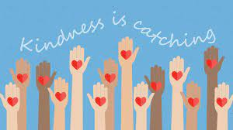
At a time of global uncertainty and societal fragmentation, there is a real and pressing need to grow empathy and compassion and to challenge an existing lack of concern for, or connection with the suffering of others and the degradation of the planet. In order to make a difference in this regard, me and my 7th graders took part in the eTwinning project `T.A.S.K - Teens in action spreading kindness`, with partners from Poland, Italy, Portugal, Turkey, Greece, Croatia, Finland and The Netherlands. In what follows, I want to share with you some activities which the students did throughout the project.

Slide 3
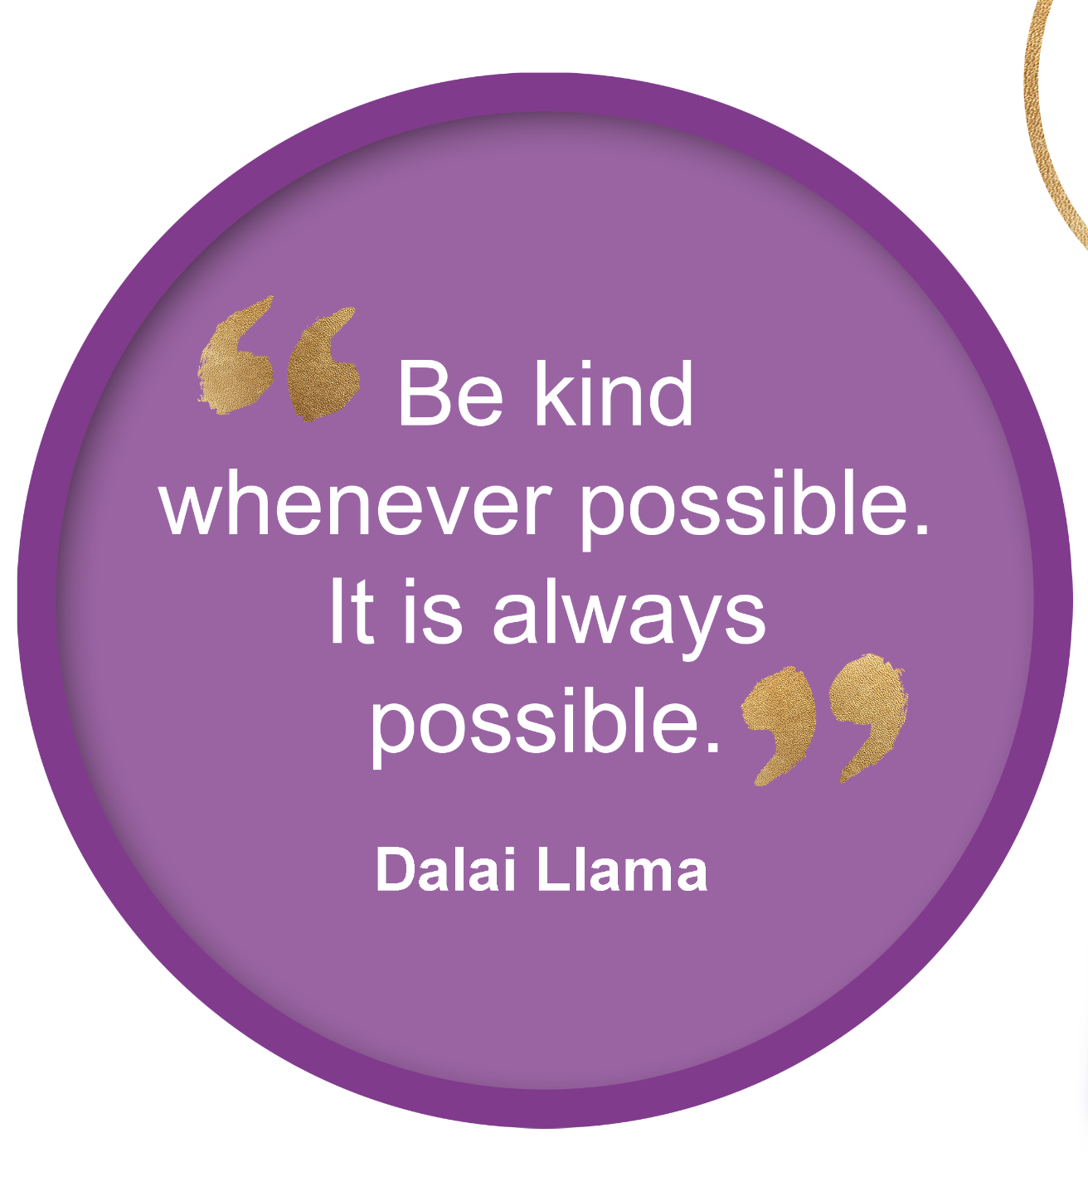

Slide 4

https://view.genial.ly/5fa2ba00b734740d79506052/interactive-image-world-kindness-day
We looked at the Genial.ly presentation to learn about World Kindness Day. (WKD) and played the kahoot Quiz in the end.

Slide 5
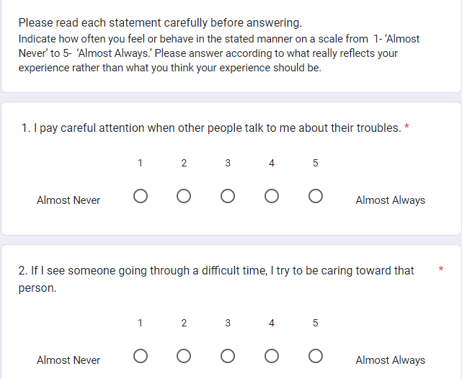
Questionnaire on Compassion to Others
Before starting our Kindness/ Compassion Boost activities, we filled in this online questionnaire on Google Forms. This compassion scale was designed by Pommier, E., Neff, K. D. & Tóth-Király I. (2019). The development and validation of the Compassion Scale. Assessment, 21-39.

Slide 6
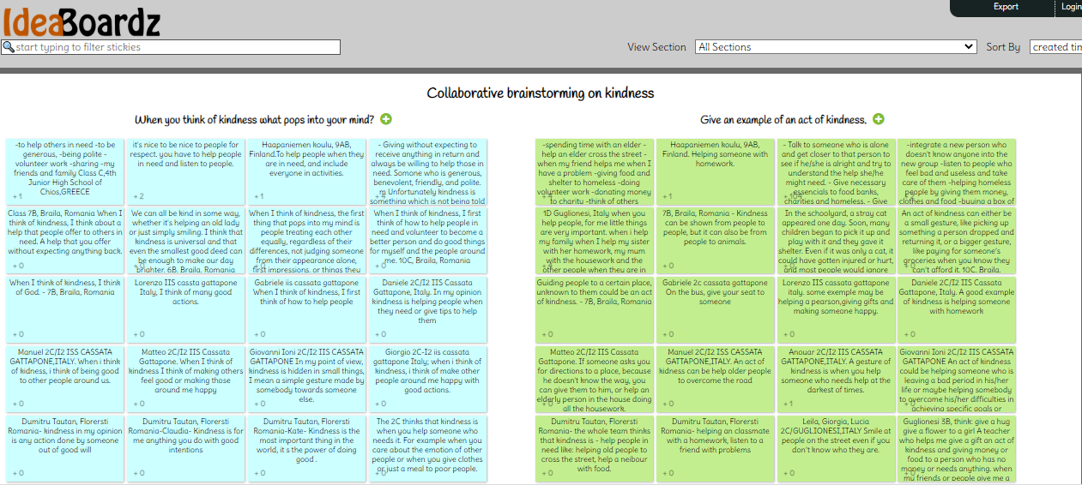
Collaborative brainstorming on kindness
As part of the eTwinning project in which we were involved during this school year (”TEENS IN ACTION SPREADING KINDNESS”), we discussed in class about kindness and compassion and registered the conclusions of the discussion on this IdeaBoardz.

Slide 7

Writing an essay
We wrote a paragraph based on the following quote:
“If you want others to be happy, practise compassion. If you want to be happy, practise compassion.” (Dalai Lama XIV, The Art of Happiness).

Slide 8
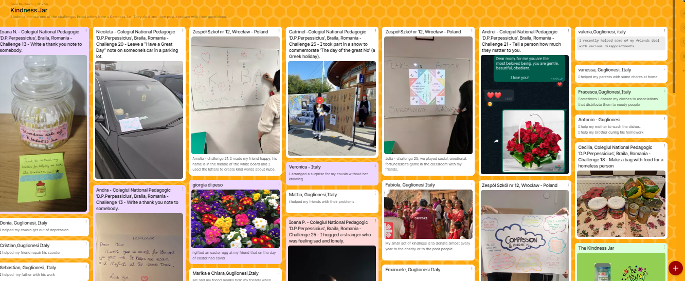
Kindness Jar
We picked up World Kindness Day challenges from the Kindness Jar (small acts of kindness written on pieces of paper) and did the task during the weeks of WKD and Thanksgiving.
Together with our friends from the eTwinning project, we shared a photo or video and a description of our acts of kindness on this collaborative Padlet. https://padlet.com/munteanusilvia2000/kindness-jar-3ftvtwrnd3lmab9f

Slide 9
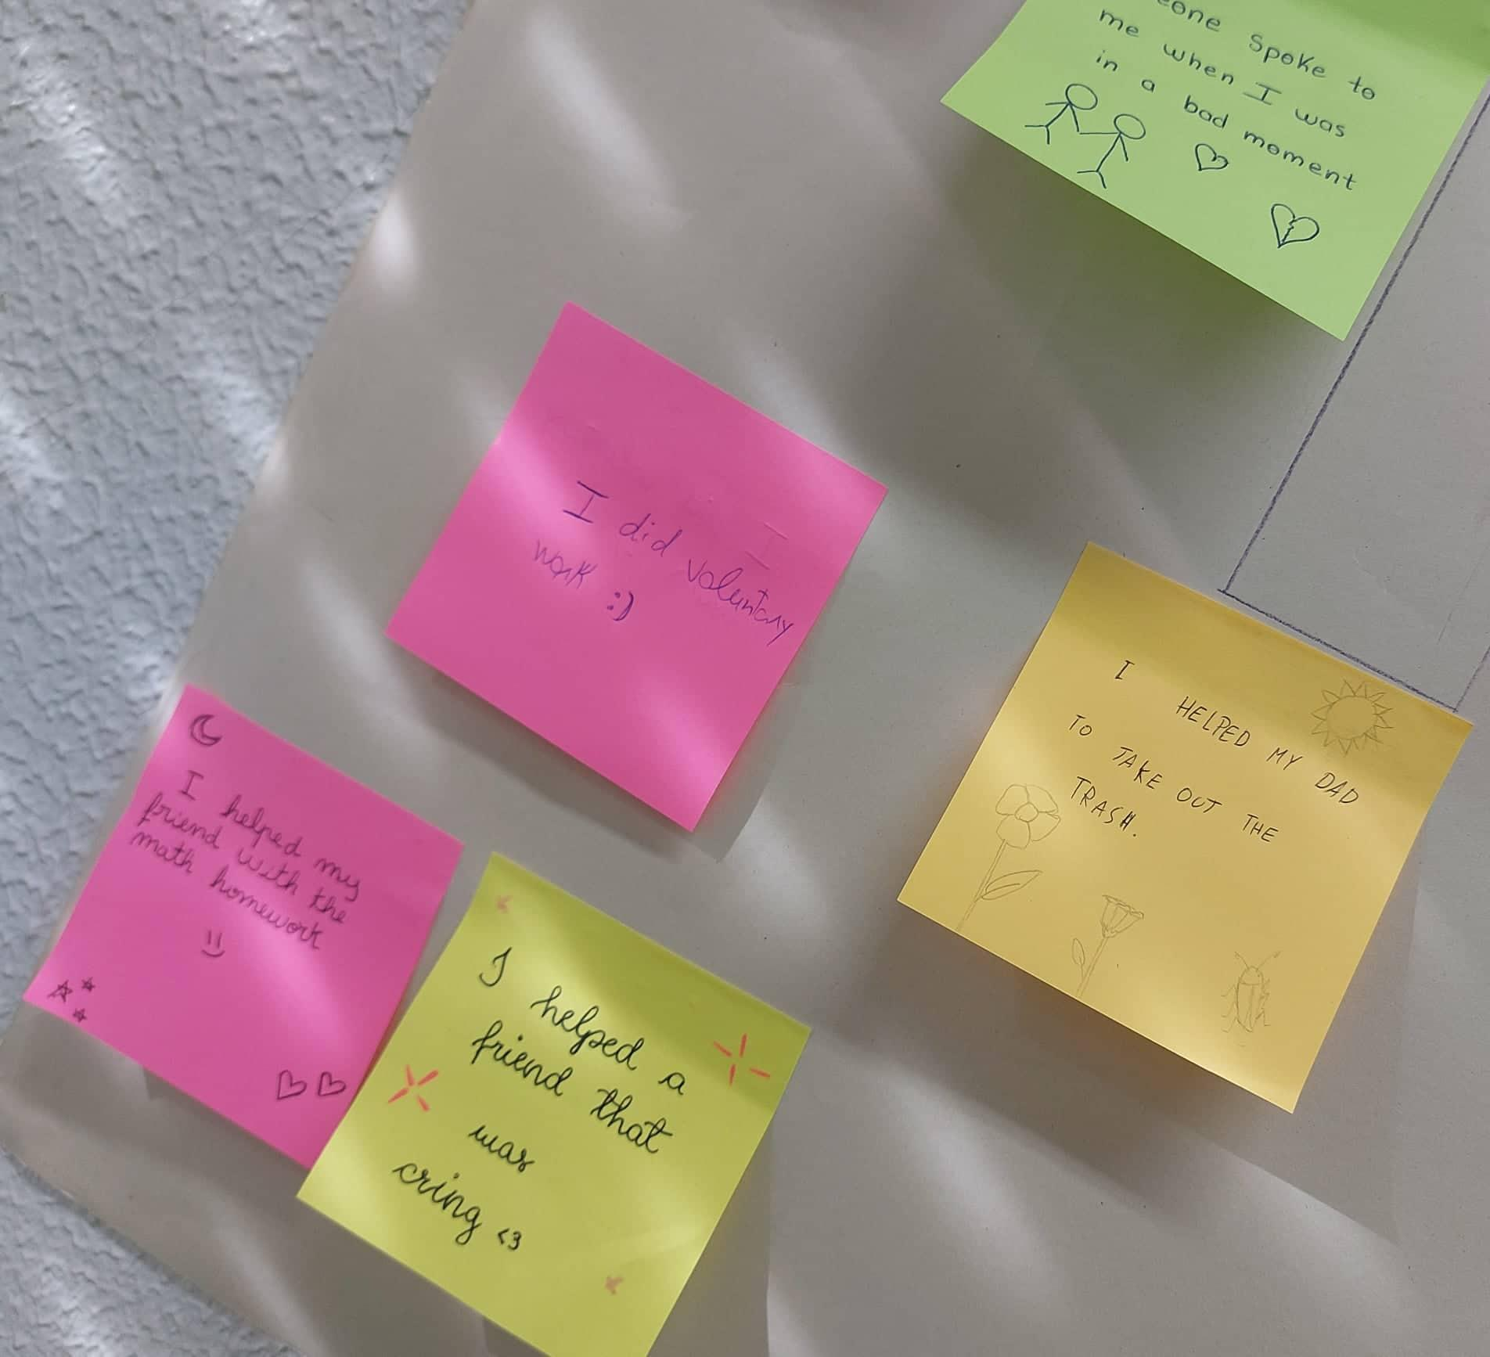
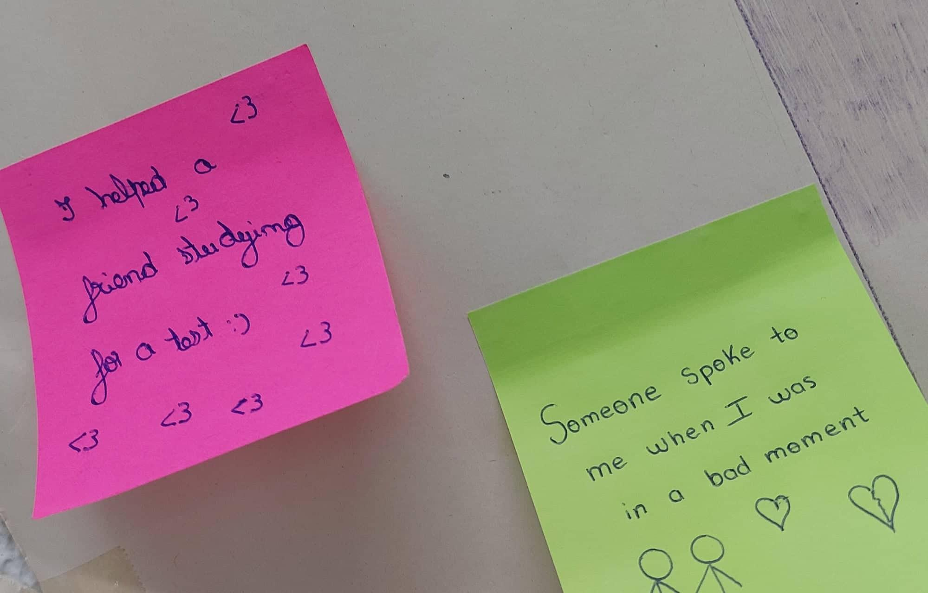
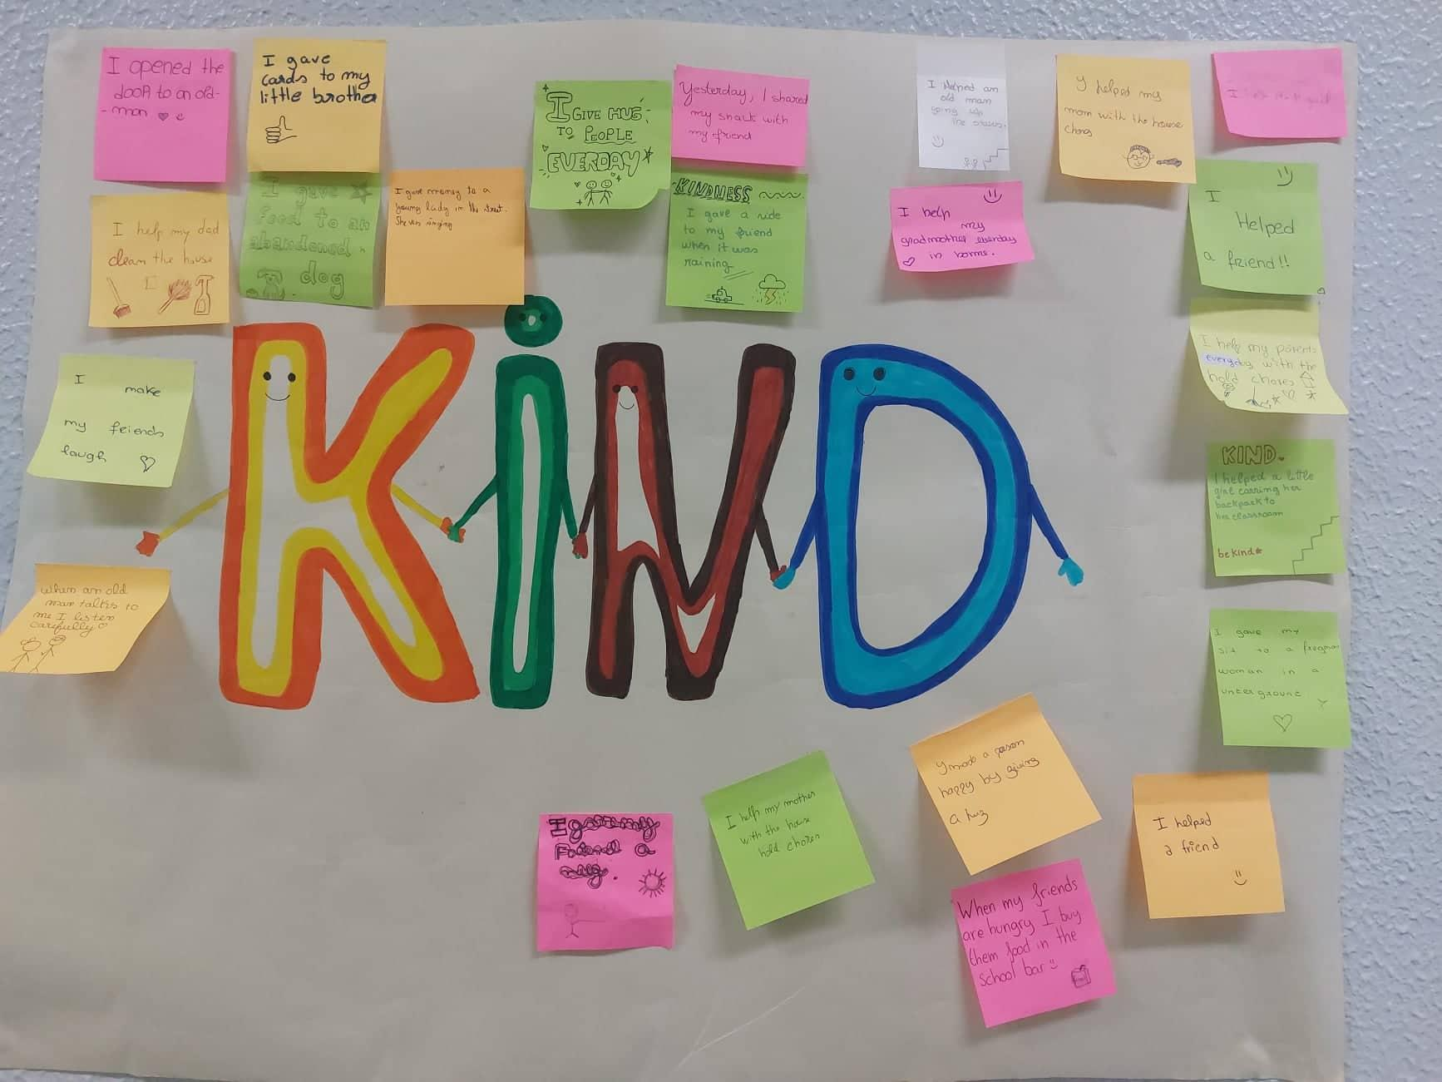
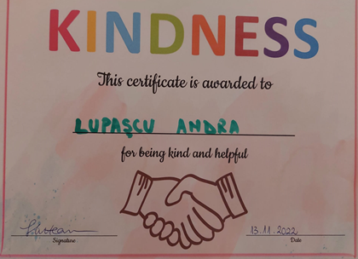
Kindness Catchers
Between WKD (November 13) and Thanksgiving Day (November 24) we wrote Post its and left them on the class wall everytime we did or received an act of kindness.
As a reward, all the students were awarded a Certificate of Kindness.

Slide 10
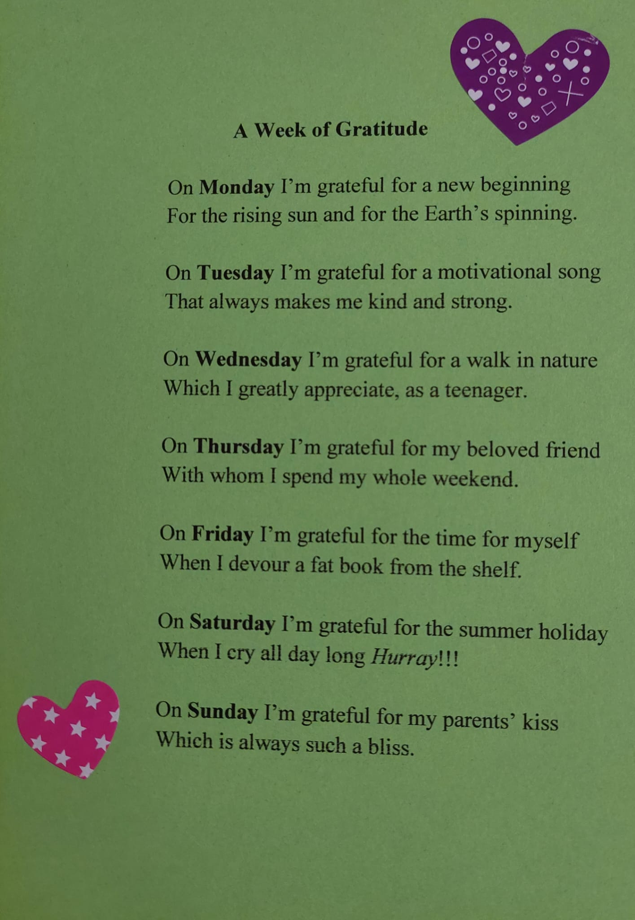
A Week of Gratitude
We wrote a collaborative poem, entitled
“A Week of Gratitude”
to celebrate
World Kindness Day.

Slide 11
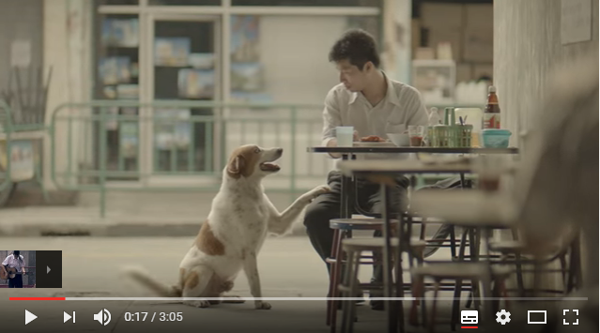
Unsung Hero
We watched the video called ”Unsung Hero” and reflected on it, identifying the kind acts presented there. https://www.youtube.com/watch?v=uaWA2GbcnJU

Slide 12
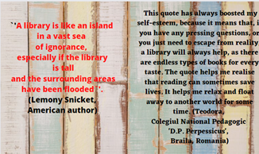
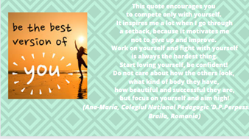
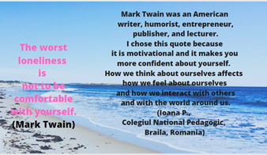
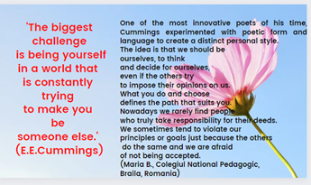
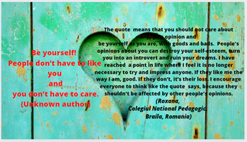
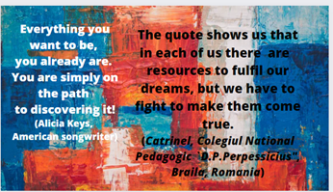
Self-Esteem boost quotes
Together with our partners, we chose an inspiring quote that makes us and the others feel good and explained why we chose it.
https://www.canva.com/design/DAFihlmYzKY/dv5KxvADpulnZTrnI6ZnXg/edit

Slide 13
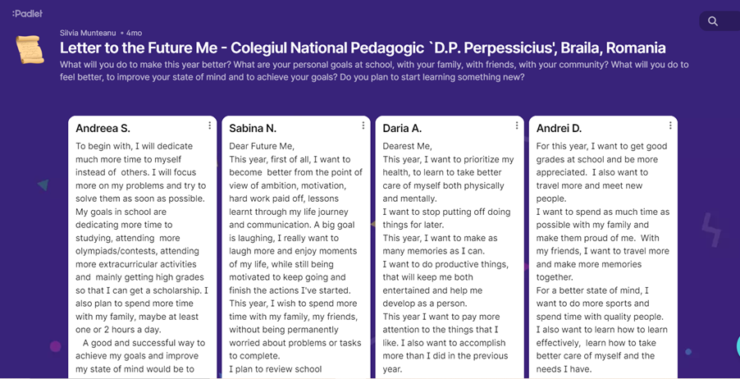
Writing a letter to the future self
https://padlet.com/munteanusilvia2000/letter-to-the-future-me-colegiul-national-pedagogic-d-p-perp-zl2istachm202jop

Slide 14
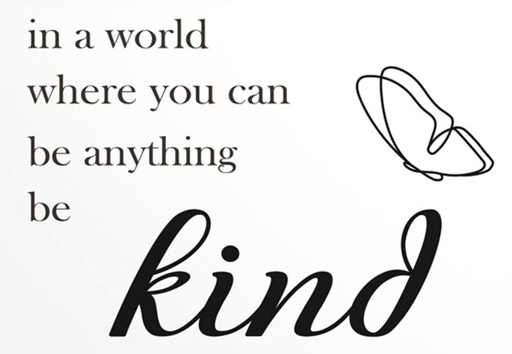
We do hope that the future generations will be more respectful, responsible, healthy and caring.
We can make this world a kinder one!!!

