Slide 1
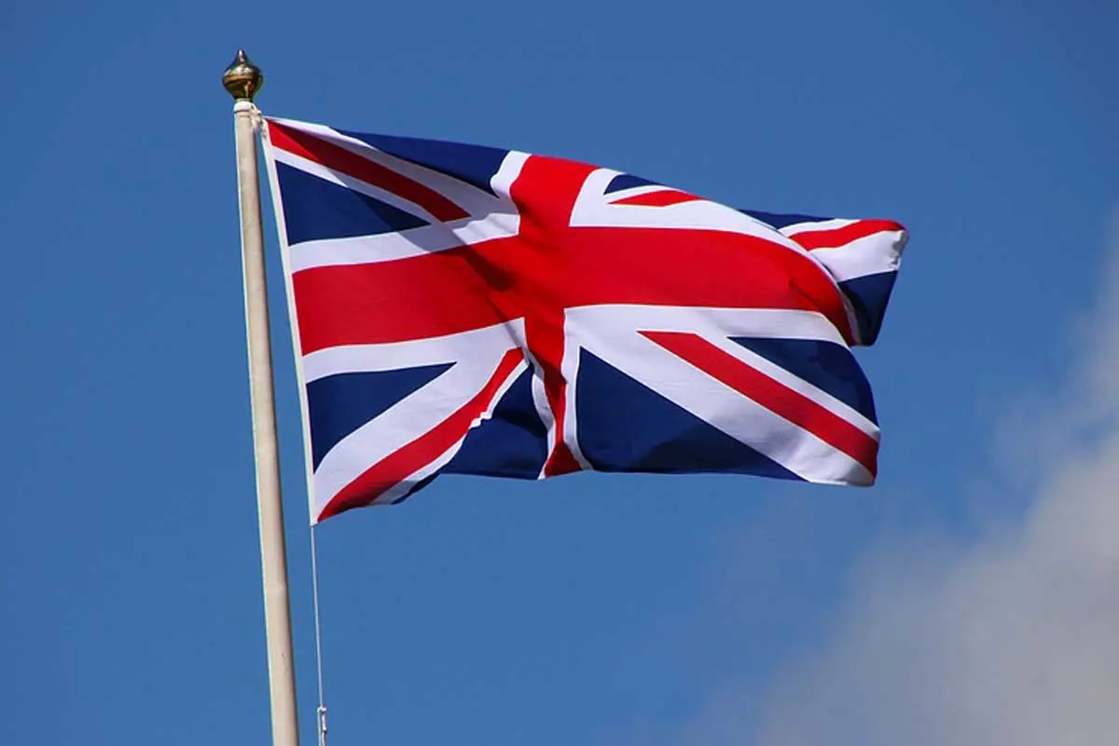
Funny or unknown things about the UK
BRITISH CULTURE AND CIVILISATION
X th GRADE
TEACHER: BILITZ VERONICA
”NICOLAE IORGA ” NATIONAL COLLEGE, BRĂILA

Slide 2
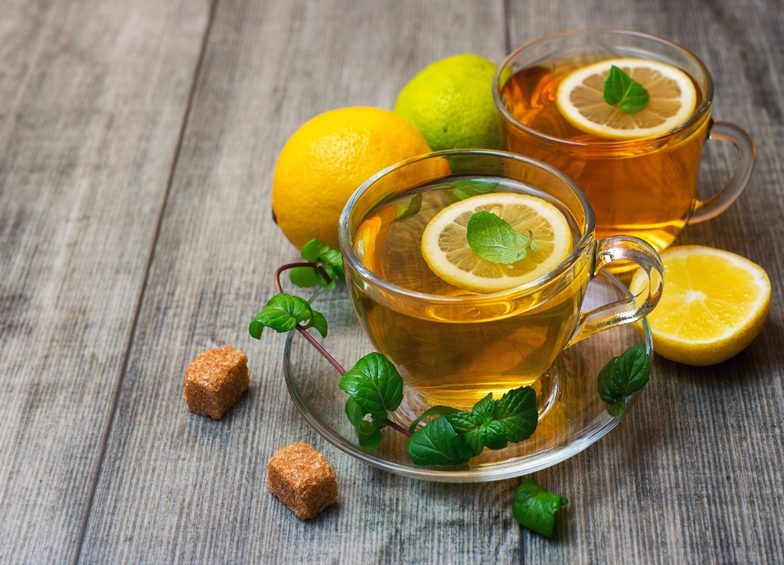
1. TEA
It is by far the most famous drink among Brits. It is estimated that they drink 165 million cups of tea every day. The fun thing here is that in the U.S. the tea’s consumption is 20 times lower.

Slide 3
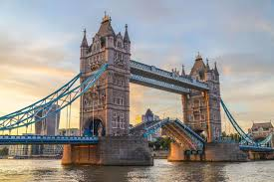
2. The Capital
London houses more than 8 million citizens who communicate via different languages. It is estimated that more than 300 languages are spoken in the city.

Slide 4
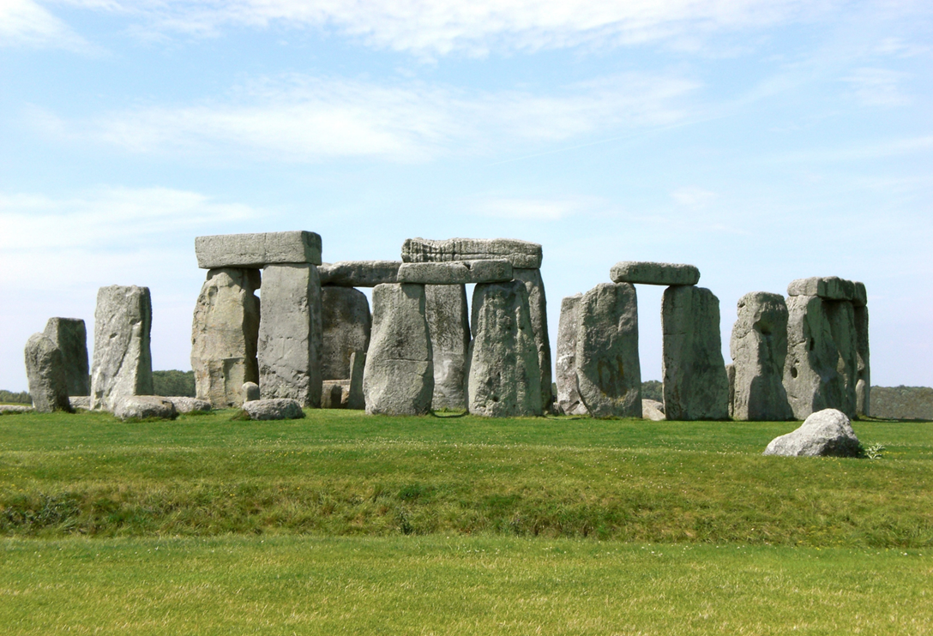
3. The Oldest Monument
The monument of Stonehenge is claimed to be one of the oldest monuments in the world, scientists believe that it was built over in 3,000 B.C.

Slide 5
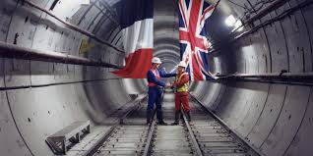
4.Links
European continental land is linked with The U.K. through the Channel Tunnel. It connects the city of Calais (France) and Dover (England). At 21 miles this road is the second-longest underground tunnel.

Slide 6
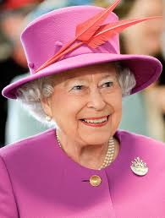
5. The Sovereign
Elizabeth Alexandra Mary (Elizabeth II) was born in 21st April 1926 at Greater London, England, and was the queen of Great Britain and Northern Ireland
from February 1952, when her father- king George VI
died, until 8th of September 2022.
HRH Queen Elizabeth II died at the
age of 96 and had the
longest-reign in the world-70 years
and 214 days.

Slide 7
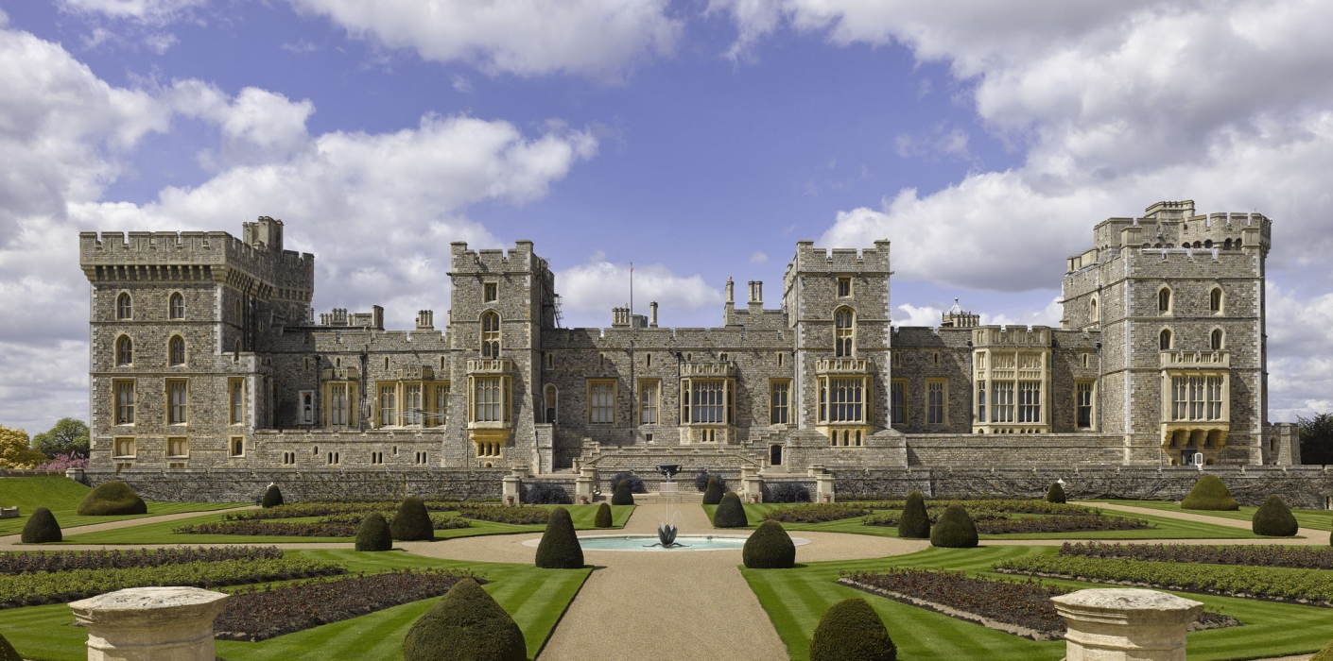
6. Royal Residences
The British royal family still resides at The Windsor Castle making it the oldest royal residence.

Slide 8
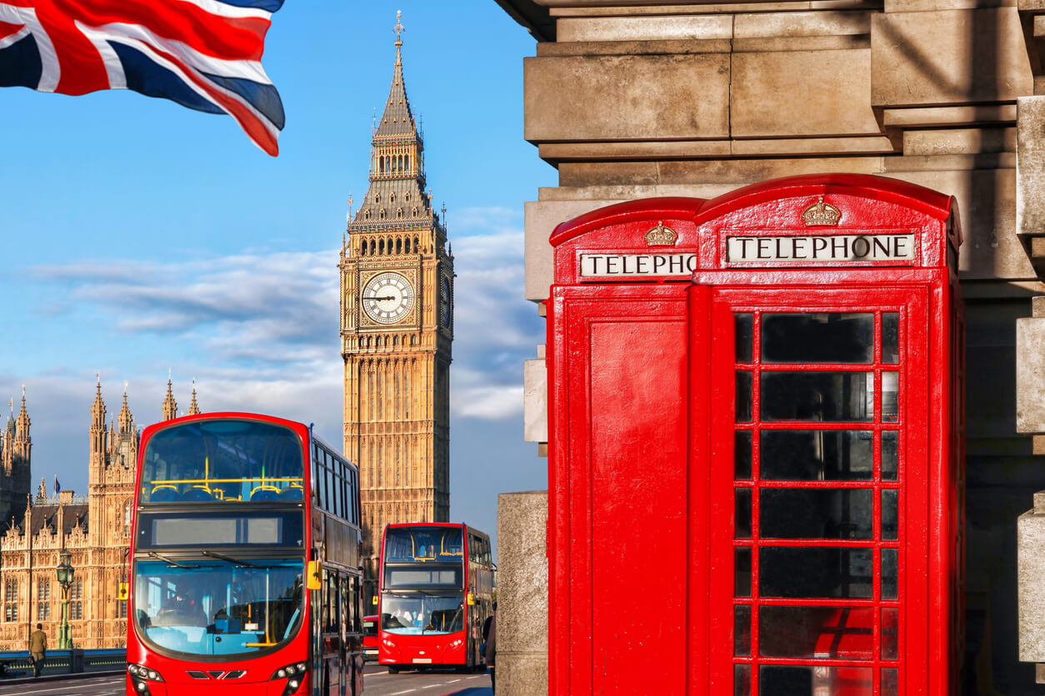
7. Language
English is the official language of the U.K., yet there are various accents throughout the country. The emphasis changes so often that within a few km, you may come across a different accent.

Slide 9
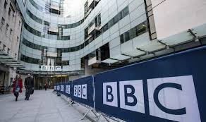
8. BBC
BBC’s T.V. channel programmes do not display ads, because they are a public broadcasting operator and are paid for by the citizens.

Slide 10
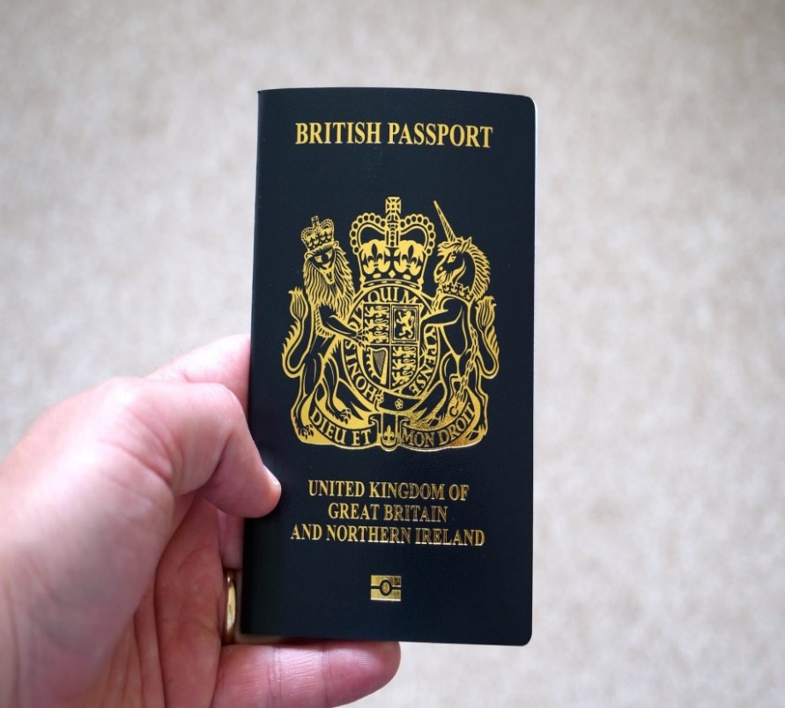
9. Travelling
The British passports are issued in the name of the Queen, and as such, her excellence did not need to have one.

Slide 11
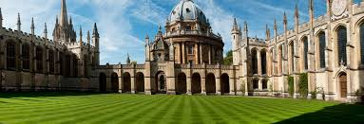
10. Education
Oxford University is the oldest higher education institution in the U.K. Until 1877, its lecturers were not allowed to get married.

Slide 12
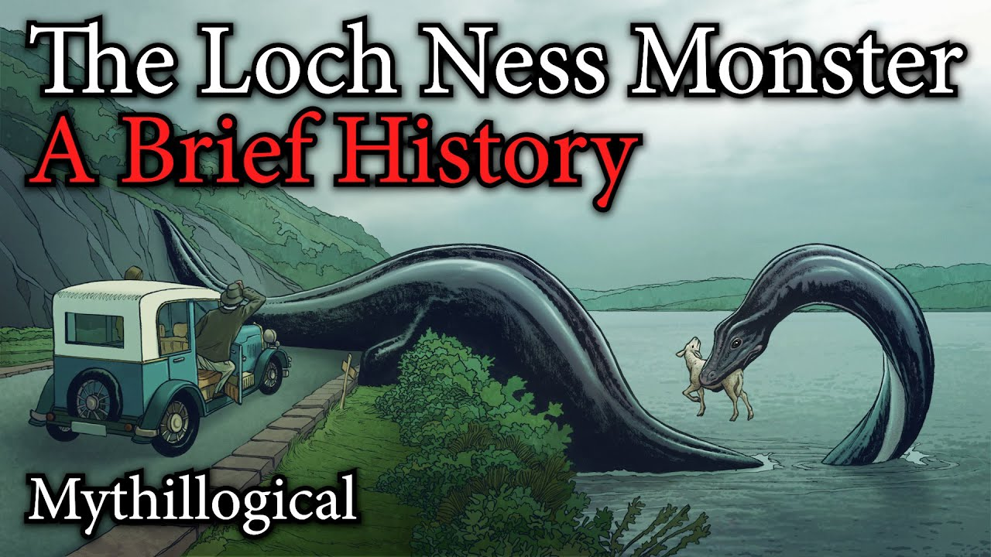
11. Mythology
Legends and Myths involving monsters and mysterious creatures are popular stories in the U.K. many people have claimed they have witnessed such beings in the past. Such accounts have also surrounded the London Bridge where some people have heard the voice of a woman roaming in the night. There are stories of the Loch Ness or shortly Nessie, based out of the lake in Scotland, it allegedly inhabits.

Slide 13
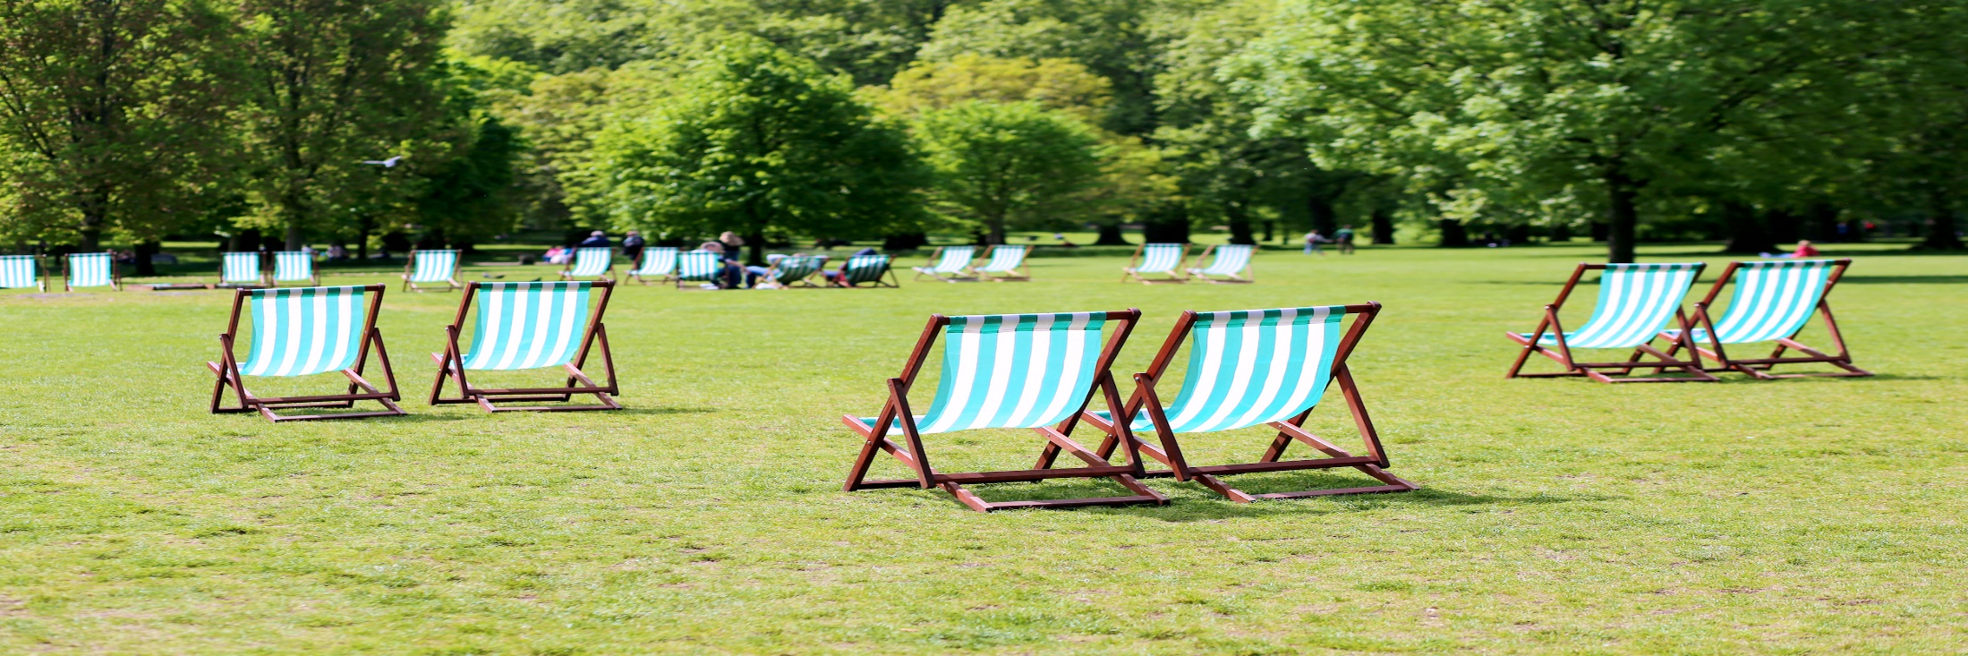
12. Geography
There are no active volcanoes in the U.K.
The U.K. has only 15 National Parks, but they only cover 8% of British land.
No mountains in England are higher than a thousand meters.
Ben Nevis is the tallest point of the U.K.’s mountains at 1,345 meters above the sea level.

Slide 14
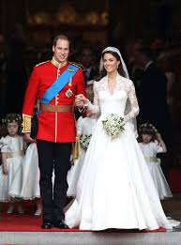
13. Royal weddings
Royal weddings are national holidays. The day after the ceremony, people get a day off work.

Slide 15
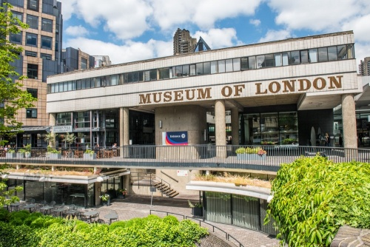
14. Museums
London has over 170 museums.
The Tower of London — or at least the White Tower within it — dates back to 1078. Built by William the Conqueror as part of his Norman Conquest, The Tower was consequently extended over the next few centuries, with subsequent monarchs making their own mark. It began accepting members from the public in 1660. Privileged members of the public with special permission had been able to visit before this for a number of years.

Slide 16
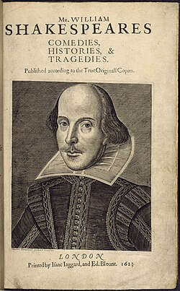
15. Shakespeare’s language
Shakespeare added approximately three-thousand words to the English language.
An early dictionary is a Latin-English dictionary which went into several editions in the sixteenth century.

Slide 17
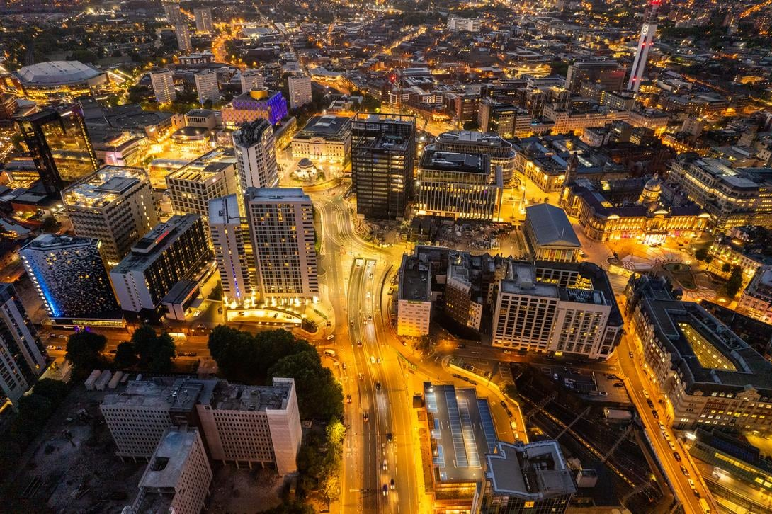
16. Other major cities
There are over thirty places around the world named Birmingham; furthermore, there are places on the Moon that hold this name. Birmingham is the second-largest city in the U.K.
Uk is a vast country, but no matter where you stay, you’ll never be further than 115 km from the sea.

Slide 18
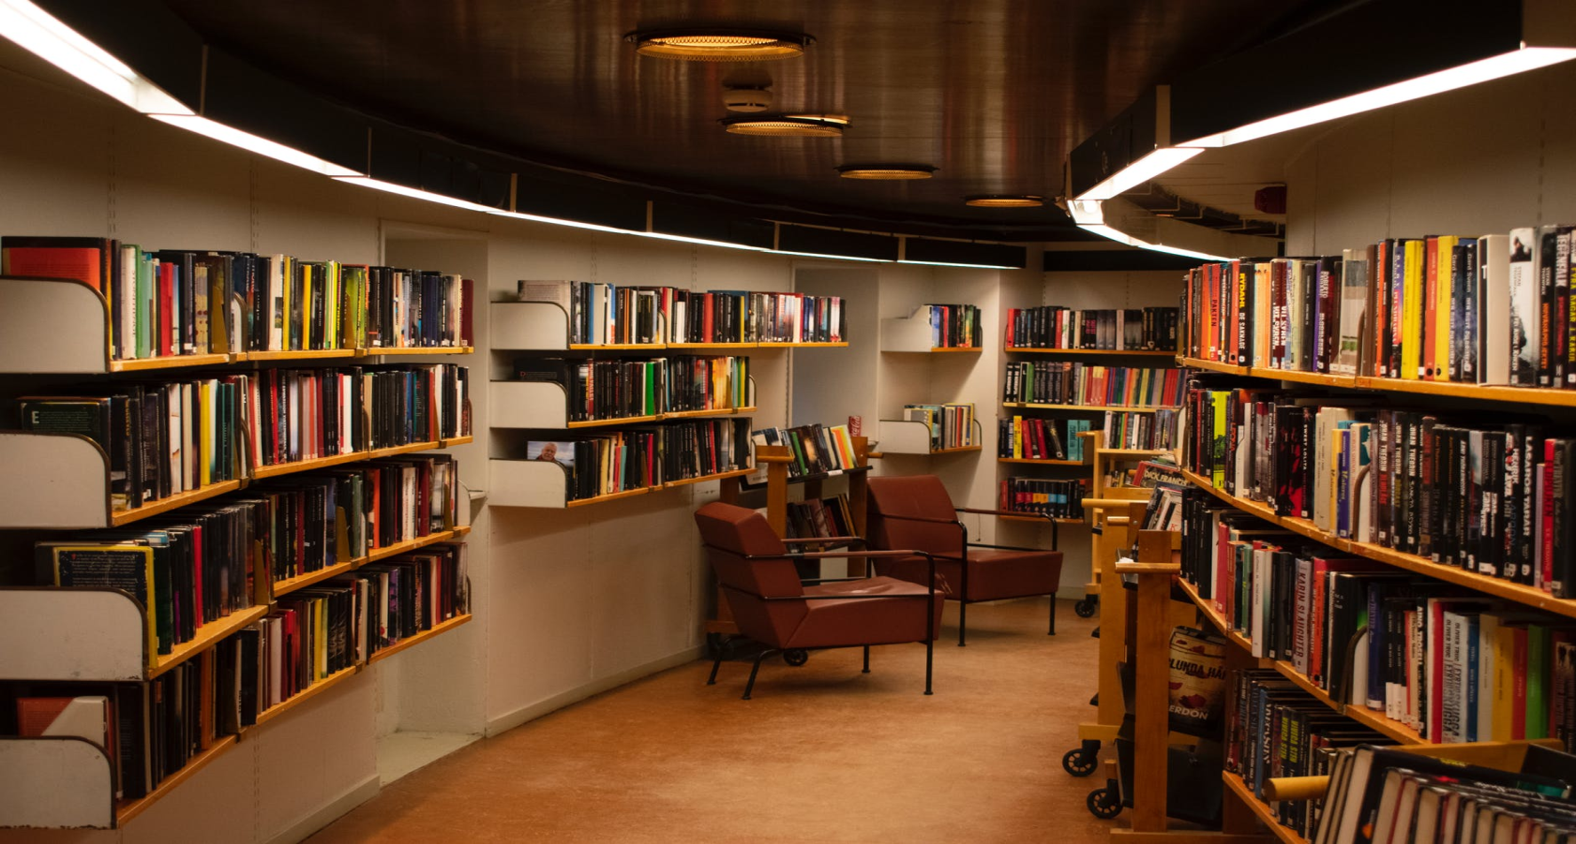
17. Culture
British Library is the 2nd largest library in the world, housing over 150 million items.

Slide 19

THANK YOU !

