Slide 1




PERSUASIVE LANGUAGE IN USE
ț
ă
Material realizat în conformitate cu programa școlară în vigoare, aprobată MEC

Slide 2
What We'll Cover
Foundations of Persuasion
Understanding the fundamental techniques and psychological principles that make language persuasive.
Rhetorical Strategies
Exploring classical and modern approaches to crafting compelling arguments.
Persuasion in Action
Analysing real-world examples across various contexts, from advertising to politics.
Ethical Considerations
Examining the responsibilities that come with the power of persuasive language.

Slide 3

The Power of Persuasive Language
Persuasive language is deliberately designed to influence thoughts, feelings, and behaviours. Throughout history, it has:
Sparked revolutions and social movements
Built powerful brands and consumer loyalty
Shaped public opinion on critical issues
Driven political campaigns and electoral outcomes
Effective persuasion requires understanding both language and psychology—how words trigger emotional and intellectual responses.

Slide 4






Aristotle's Rhetorical Triangle
Pathos
Appeals to emotion
Stories and anecdotes
Evocative imagery
Emotional language
Logos
Appeals to logic and reason
Facts and statistics
Logical arguments
Evidence and data
Ethos
Appeals to ethics and credibility
Trustworthiness
Expertise and authority
Shared values
These three appeals, first identified by Aristotle in 4th century BCE, remain the foundation of effective persuasion today.

Slide 5
The Psychology of Persuasion
1
2
Reciprocity
People feel obliged to return favours, making "give before you ask" a powerful technique.
Social Proof
We look to others' behaviour for guidance, hence the effectiveness of testimonials and popularity claims.
3
4
Scarcity
Limited availability increases perceived value ("Only 3 left!" or "Limited time offer").
Authority
We tend to comply with requests from recognised authorities or experts in relevant fields.
These principles, identified by psychologist Robert Cialdini, explain why certain persuasive techniques consistently work across cultures and contexts.

Slide 6







Rhetorical Devices: The Tools of Persuasion
Sound-Based Devices
"Fresh, fabulous flavour" "The best defence is a good
offence"
"Ask not what your country can
do for you..."
Structure-Based Devices
"Yes we can, yes we can" "Of the people, by the
people, for the people"
"Education, education,
education"
Meaning-Based Devices
"Life is a journey"
"I've told you a million times"
"The brain is like a computer"
These devices make language more memorable, impactful, and persuasive by playing on cognitive biases and emotional responses.

Slide 7

Powerful Persuasive Words
Words That Promise
Words That Connect
Free, Save, Guarantee
Proven, Tested, Trusted
Exclusive, Limited, Special
You, Your, Yourself
We, Together, Community
Imagine, Discover, Experience
Words That Motivate
Now, Today, Instantly
Easy, Simple, Effortless
New, Innovative, Revolutionary

Slide 8

Case Study: Advertising Language
Sensory Language
Advertisements use vivid sensory words to create immediate desire: "Crisp, refreshing taste" or "Silky-smooth texture" trigger sensory imagination.
Imperative Verbs
Direct commands create urgency and prompt action: "Discover the difference, " "Taste the feeling," "Just do it" bypass conscious decision-making.
Problem-Solution Structure
Advertising often identifies a problem before offering the product as the solution, creating both anxiety and relief in quick succession.

Slide 9



Case Study: Political Speeches
Political speeches represent persuasion at its most consequential, often
using:
("we," "our") to create unity to frame debates as clear choices
to stir strong feelings
to add weight and context to simplify complex policies
Effective political rhetoric balances emotional appeals with policy
substance, often using personal stories to humanise abstract issues.

Slide 10
Cialdini's Six Principles in Action
Reciprocity
"Download our free guide now" - Offering value before asking for sign-ups
1
Consistency
"You care about the environment; that's why our eco-friendly products are perfect for you" - Aligning with existing beliefs
2
Social Proof
"Join over 10,000 satisfied customers" - Showing that others approve
3
Liking
Using relatable spokespeople who share values with the target audience
4
Authority
"Recommended by 9 out of 10 dentists" - Leveraging expert endorsement
5
Scarcity
"Limited edition - while stocks last" - Creating urgency through limited availability
6

Slide 11
Persuasive Structures
Problem
Identify a pain point or challenge that resonates with your audience
Solution
Present your idea, product, or service as the answer to their problem
Evidence
Provide proof that supports your solution (statistics, testimonials, examples)
Call to Action
Direct the audience towards a specific response or next steps
This problem-solution structure creates a narrative arc that builds tension before offering relief, making the proposed action seem natural and necessary.

Slide 12



Persuasion Across Platforms
Social Media
Brief, emotive content with strong visuals. Uses hashtags, trending topics, and shareability to spread persuasive messages quickly.
Print Media
Headline-driven persuasion with greater depth. Uses authoritative tone, expert quotes, and detailed evidence to build credibility.
Broadcast Media
Visual storytelling with emotional impact. Combines verbal and non-verbal persuasion through tone, music, imagery, and personal stories.
Each medium requires adapting persuasive techniques to fit the audience expectations and platform constraints.

Slide 13

The Dark Side: Manipulation vs. Persuasion
Ethical Persuasion
Manipulative Tactics
Respects audience autonomy
Presents balanced information
Makes transparent arguments
Benefits both parties
Avoids deception
Uses false information or fabrications
Exploits fears or insecurities
Intentionally omits crucial information
Creates artificial pressure
Benefits only the persuader
Understanding the distinction between ethical persuasion and manipulation is crucial for both creating and consuming persuasive content responsibly.

Slide 14
Logical Fallacies: Flaws in Reasoning
Ad Hominem
Attacking the person instead of addressing their argument
"You can't trust her environmental policy; she drives an SUV!"
False Dichotomy
Presenting only two options when more exist
"Either we cut taxes, or the economy will collapse."
Straw Man
Misrepresenting an opponent's argument to make it easier to attack
Appeal to Popularity
Suggesting something is correct because many people believe it
"Everyone is using this product, so it must be good."
"You want healthcare reform? So you want government controlling
our lives!"
Recognising these fallacies helps us evaluate persuasive messages critically and construct stronger arguments ourselves.

Slide 15




Persuasion in Digital Media
Clickbait Headlines
Create curiosity gaps that exploit our need for closure: "You won't believe what happened next" or "The shocking truth about..."
Microtargeting
Uses data to deliver highly personalised persuasive messages based on specific interests, behaviours, and demographics.
Social Validation
Visible metrics (likes, shares, views) function as digital social proof, influencing how we perceive content credibility.

Slide 16
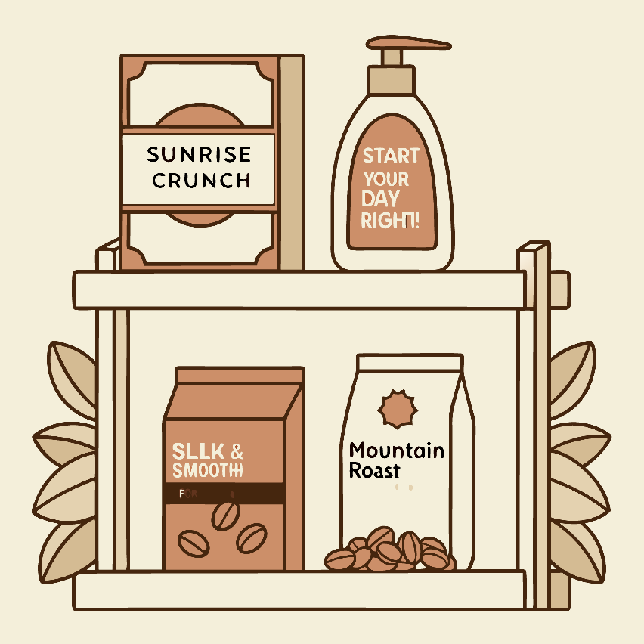
Case Study: The Language of Brands
Successful brands develop distinctive language patterns that build
^{recognition}usªe^{n}s^{d}m^{lo}i^{y}nªim^{lty}a:list language with words like "revolutionary" and "mageicmalp"loys direct, active language with the imperative "Just Do It"
uses conversational, playful language with humour and wordplay
This consistent language creates a recognisable brand voice that resonates with target audiences and differentiates from competitors.
Brand language often reflects core values and personality traits that appeal to specific market segments, creating emotional connections beyond product features.

Slide 17
Analysing Persuasive Texts
Identify the Purpose
What is the text trying to achieve? Is it selling a product, promoting an idea, or changing behaviour?
Examine the Appeals
How does it balance logos (logic), pathos (emotion), and ethos (credibility)? Which predominates?
Spot the Techniques
What specific rhetorical devices and persuasive structures are being employed?
Consider the Context
How do medium, audience, and timing influence the persuasive approach?
Evaluate Effectiveness
Does the text achieve its persuasive goals? Why or why not?

Slide 18
Crafting Your Own Persuasive Language
Know Your Audience
Research their values, needs, concerns, and language patterns to
tailor your approach effectively.
1
2
Clarify Your Purpose
Define exactly what response you want—whether it's changing opinions, prompting action, or building awareness.
Balance Your Appeals
Combine logical arguments with emotional resonance and
establish your credibility on the subject.
3
4
Choose Powerful Language
Select vivid, specific words and rhetorical devices that enhance memorability and impact.
Structure Strategically
Organise your message to build interest, address objections, and
lead to a clear call to action.
5

Slide 19

Ethical Considerations
Truth and Accuracy
The ethical persuader commits to factual accuracy and avoids deceptive claims, even when inconvenient.
Respect for
PAeurstuoansoiomn syhould aim to convince through reason and emotion, not coerce or manipulate through deception.
Consideration of
RCeosnposnesqibulee npecressuaders consider the potential impacts of their messages on individuals and society.
Transparency of
IMnatkeinngtpersuasive goals clear rather than disguising them as neutral information shows respect for the audience.

Slide 20





Key Takeaways
1
Master the
craf t
2
Balance logos,
pathos, ethos
3
Recognise techniques
in media
4
Use persuasion
responsibly
Persuasive language surrounds us in advertising, politics, education, and everyday interactions
5
Understanding persuasive language empowers you both as a communicator and as a critical consumer of information. The techniques we've explored can be powerful tools for positive change when used ethically and responsibly.
What persuasive techniques will you spot in your daily life now that you know what to look for?

Slide 21

Dobre, C., & Stănilă, L. (2020). Limba engleză. Manual pentru clasa a XII-a. București: Art Educational.
Coman, A. (2017). Limbajul argumentativ în limba engleză. București: Editura Universitară.
Crystal, D. (2003). The Cambridge Encyclopedia of the English Language. Cambridge: Cambridge University Press.
Cameron, D. (2001). Working with Spoken Discourse. London: SAGE Publications.
Fairclough, N. (2013). Language and Power (3rd ed.). London: Routledge.
Jones, L. (2012). Ideas and Issues: Pre-intermediate to Upper-intermediate. Cambridge: Cambridge University Press.
Maybin, J., & Mercer, N. (1996). Using English: From Conversation to Canon. London: Routledge.

